Slide 1

SOF106
Final Project
Group1
Leader : Bi Xiaoyang
Member: Wang Qipeng
Zhang Yichi
Hu Yaqi
AIT2009357
AIT2009376
AIT2009380 AIT2009364

Slide 2
Abstract
Our group focused on designing a chatbot that can have daily conversations with us and make itself our chat partner under the COVID-19 situation. We named it Intelligent Companion.
Intelligent Companion is a program written in python and based on the application of artificial intelligence knowledge such as Natural Language Processing and Neural Network. Our Intelligent Companion uses a similar rule-based system and a more advanced self-learning algorithm. Improved on the restricted conversation content and the inability in generating meaningful natural language conversations, it can generate richer, meaningful, and special conversational responses.

Slide 3
1.0 Introduction
2.0 Scope of application in Malaysia BITs with NT clauses
2.1 Research Approach
2.1.1 Neural Network
2.2 Research Process
2.2.1 Dataset
2.2.2 Encoding
2.2.3 Training details
3.0 Experiment
3.1 Dataset detail
3.2 Training detail
3.3 Running configuration
3.4 Experiment results
4.0 Conclusion
5.0 Reference
Table
of
Contents

Slide 4
1.0
ONE
Introduction

Slide 5
1.0 Introduction
In this work, our team designed a chatbot named Intelligent Companion with the basic knowledge of Neural Network, Natural Language Processing, as well as Python programming.

Slide 6
1.0 Introduction
The key capabilities that Intelligent Companion has implemented is selecting the closest matched response by searching in the range of all known statements that are related to the input, it then chooses a response from the selection of known responses to that statement.In addition, we have equipped the chatbot with some mathematical knowledge, so that it can respond to some mathematical questions.

Slide 7
1.0 Introduction
As for applying the self-learning algorithm, Neural network are used to train the chatbot to reply to a user, based on the training set of interaction. Rule-based approach and self-learned approach are applied to the task part and interactions respectively, According to our research, this combined approach is found to have the promising capability to generate daily conversation.

Slide 8
2.0
TWO
Methodology

Slide 9
2.0 Methodology
Our purpose is to build a chatbot that can make them respond to our questions and generate conversation.
The two main challenges are understanding natural language and generating meaningful responses.
This part we will mainly discuss our research approach and research process.

Slide 10
2.1 Research Approach
NLTK, the Natural Language Toolkit, is a suite of Python modules providing many NLP data types, processing tasks, corpus samples, and readers, together with animated algorithms, tutorials, and problem sets .

Slide 11
2.1 Research Approach
NLTK, in this project, was used to realize 5 functions:
Morphological and Lexical Analysis
Syntactic Analysis
Semantic Analysis
Discourse Integration
Pragmatic Analysis

Slide 12
Morphological and Lexical Analysis
Syntactic Analysis
Discourse Integration
NTLK
Semantic Analysis
Pragmatic Analysis

Slide 13
2.1 Research Approach
After elaborating on the above five purposes we wanted to realize by NLTK，the methods or functions used to implement these five components are listed as follows.
Tokenization
Speech Tagging
Lemmatization

Slide 14
2.1 Research Approach
Tokenization
1
2
Lemmatization
Speech Tagging
3

Slide 15
2.1.1 Neural Network
Converting sentences into word vectors and then generating semantic matching vectors.
The neural network algorithm is used to integrate the similar and dissimilar components to obtain the feature vectors.

Slide 16
2.2 Research Process
We created a JSON file named intents, containing corresponding answers to the tags and patterns ，and also set up 3 files and got 3 new ones generated in the training:
intent.json
training_chatbot.py
chatbot.py
chatbot_model.h5, words.pki, classes.pkl

Slide 17
3.0
THREE
Experiment

Slide 18
3.0 Experiment
We applied our asking to our well-trained Intelligent chatbot. Then we can see the response from the chatbot. We can also see the accuracy and loss after running the training file, which they are visualized and represented in the python console.

Slide 19
3.1 Dataset details
We created a JSON file called intents.json, which is used in training our models. We separate them into 56 tags, each tag represents a topic when we chat with this chatbot. And under each tag, we have "patterns" and "responds", which on behalf of Q&A. These 56 Q&A topics are some conversations we think it is common in our daily life.

Slide 20
3.1 Dataset details
Neural network is easy for training our models. And to build our neural network, we use TensorFlow to reach it. we create a simple sequential model and add a couple of layers. The first layer is the input layer, which is a dense layer with 128 neurons And we specify the activation function "relu".

Slide 21
3.2 Training details
We again add a dense layer with 64 neurons and a Dropout layer as output layer . And we equal the activation function to softmax.

Slide 22

3.3 Running configuration
For IDE, we choose Pycharm 2021.1 to edit it. And we also download some packages such as nltk, numpy, TensorFlow, and some modules from TensorFlow and python standard library.

Slide 23
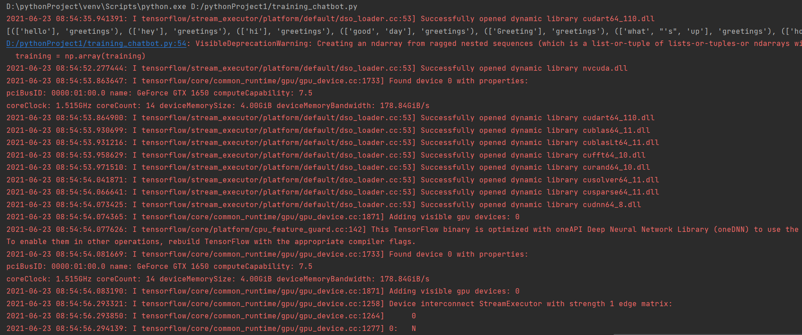
3.4 Experiment results
Figure1
We execute the training file and start to train.And it shows Tensorflow as been opened successfully.

Slide 24
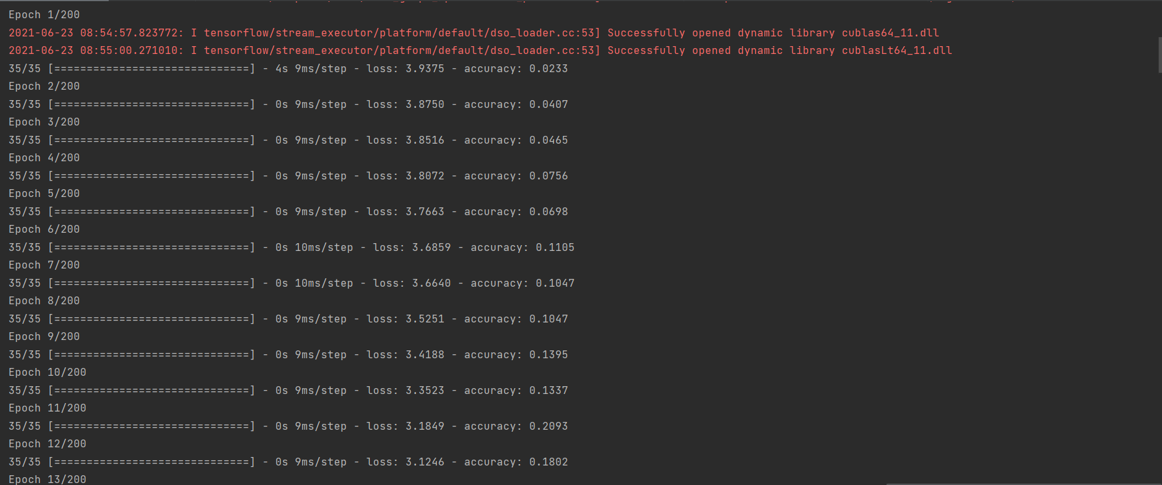
3.4 Experiment results
Figure2
We can see the data is training and shows the accuracy and loss of each epoch’s training.

Slide 25
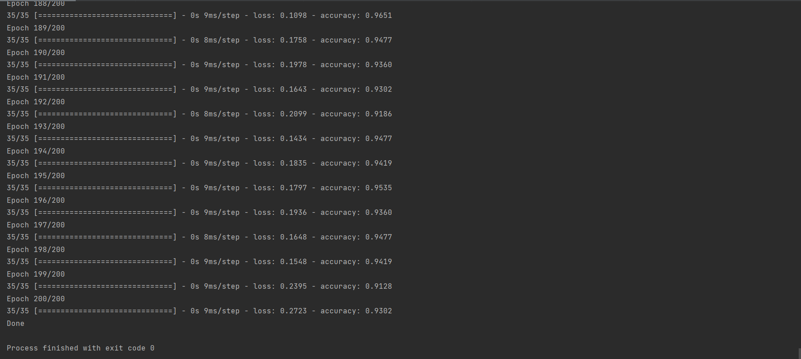
3.4 Experiment results
Figure3
After 200 epochs training ,when we see the hint word “Done!”, then we know the training work is done and our training model is built.

Slide 26
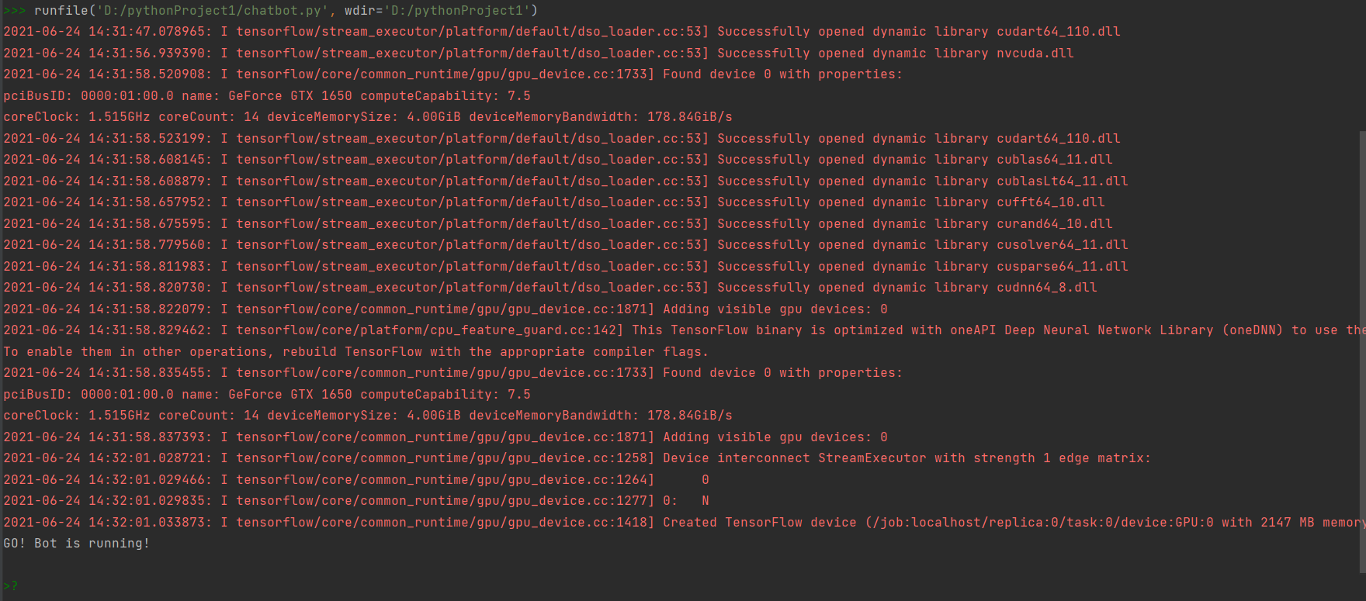
3.4 Experiment results
Figure4
We can see the chatbot is executing, and when we see a green sign “>?” it hints us we can start to chat with our chatbot.

Slide 27
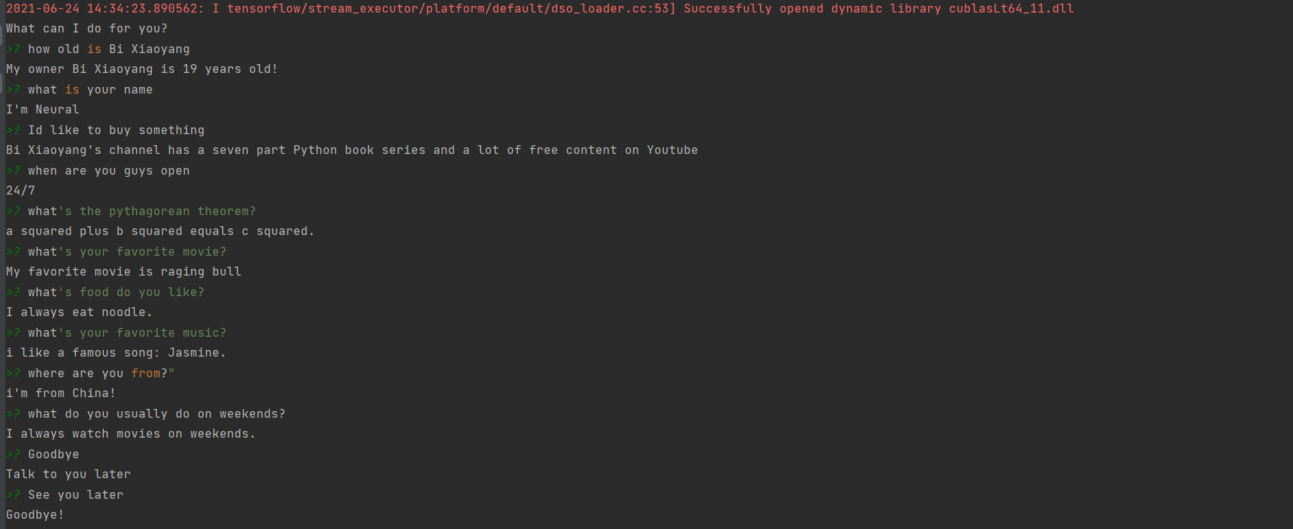
3.4 Experiment results
Figure5
When we ask the question in the intents.json, then it will make a respond.The responses are totally the same with the data we put in.

Slide 28
4.0
FOUR
Conclusion

Slide 29
4.0 Conclusion
1.Chatbot, one of the most promising areas of AI today, has been highly developed, but there are still many problems that are not solved well enough, such as the ability to link contexts and complete a real conversation as people do. This study, as a rather shallow attempt, clearly does not give a feasible direction for these remaining problems.
2.At the same time, Intelligent Companion has even more limitations: since the underlying code is derived from a rule-based system, the more complex the system is, the more rules there are, and thus it cannot be improved to a higher level. But overall, we have made our effort to design this Intelligent Companion under the COVID-19 situation, which is the first step that we have taken in our academic career to researching chatbot.

Slide 30
5.0
FIVE
Reference

Slide 31
5.0 Reference
Joseph Weizenbaum. 1966. “ELIZA a computer program for the study of natural language communication between man and machine.” Communications of the ACM, 9(1):36–45.
Christopher D Manning, Christopher D Manning, and Hinrich Schutze. 1999. ¨ Foundations of statistical natural language processing. MIT press.
Maali Mnasri Opla / Clermont-Ferrand, 2019, “France Recent advances in conversational NLP : Towards the standardization of Chatbot building”.
Ilya Sutskever, Oriol Vinyals, Quoc V. Le,2014, “Sequence to Sequence Learning with Neural Networks”.

Slide 32
Thanks

